Slide 1
A Neural Oscillator for Position Controlled Joints
Sayantan Auddy

Slide 2
Motivation
Legged robots can go places wheeled robots cannot
Efficiency of human movement
Stable bipedal motion – difficult to achieve
ZMP based approaches do not utilize dynamics of the robot
Alternative bio-inspired approach
Talk a bit about alternative approaches
CPGs in position controlled robots
Notes:
Video of baby taking first steps.
https://www.youtube.com/watch?v=1H_XqO5OwWM
https://www.youtube.com/watch?v=jOIgR4o9Iu8
https://www.youtube.com/watch?v=jIzuy9fcf1k
Why are walking robots useful
How do humans and other animals walk
The neural circuitry for rhythmic motion is already present
Practice needed for balancing and fine tuning walk

Slide 3
Outline
Biological background of neural oscillators
Half-center neuron model
Matsuoka oscillator
Coupling multiple oscillators
Matsuoka oscillator to drive a position controlled joint
Joint control demonstration
Future work (master thesis spot talk)

Slide 4
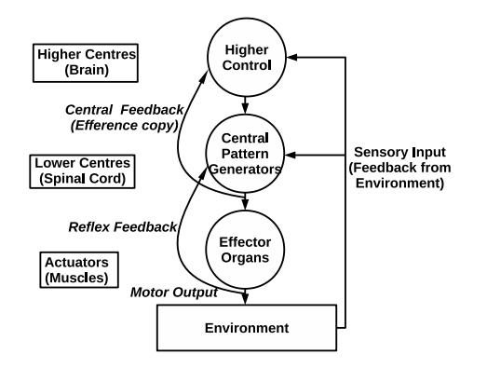
Biological Background
Neural Circuits (CPGs) exist in the spinal cord
Rhythmic patterns produced without rhythmic input
Sensory feedback used for modulation
Neural components of motor systems

Slide 5

Half-center neuron model
Proposed by Brown to explain movements of a decerebrated cat
Self and mutual inhibition leads to switching of activity
CPG
i
E
Driving neuron pool
Interneuron pool
Motor neuron pool
Inhibitory connection
Excitatory connection
D
$$j$$
F

Slide 6
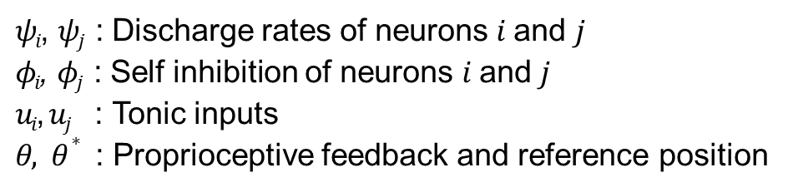
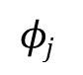

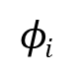
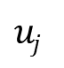
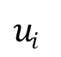



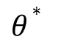

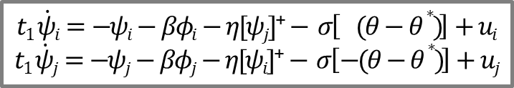
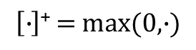
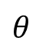
Matsuoka Oscillator
Mathematical model of neural rhythm generators
Based on a piece-wise linear set differential equations
$$t1 \dot{ψi}=−ψi−βφi−η[ψj]\text{+}− σ\left[ (θ−θ∗ )\right]+ui$$
$$t1 \dot{ψj}=−ψj−βφj−η[ψi]\text{+}− σ\left[−(θ−θ∗ )\right]+uj$$
$$φi$$
Proprioceptive
feedback
$$ui$$
$$ψi$$
E
$t2 \dot{φi}=−φi+[ψi]$⁺
$t2 \dot{φj}=−φj+[ψj]$⁺
D
$$uj$$
$$θ$$
$$ψj$$
F
$$ψT=hψ([ψi]\text{+}−[ψj]\text{+})$$
$$φj$$
$θ∗$
$$I\ddot{θ}+γ\dot{θ}−ψT=0$$
$ψi$, $ψj$ : Discharge rates of neurons $i$ and $j$
$φi$, $φj$ : Self inhibition of neurons $i$ and $j$
$ui$, $uj$ : Tonic inputs
$θ, θ∗$ : Proprioceptive feedback and reference position
$$\left[∙\right]\text{+}=max(0,∙)$$
Notes:
Mathematical model of neural rhythm generators
Set of mutually inhibiting neurons
Based on a piece-wise linear set differential equations

Slide 7



Pattern Modulation
Joint torques
Joint angles
-- joint angle
-- reference position
Reference angle $θ^{∗}$ varied
(0 to 1 to -1 radians)
Tonic inputs $u_{i},u_{j }$varied from 1.0 to 4.0
Time constant $t_{1}$varied (0.3 to 0.6 to 0.9s)

Slide 8

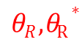

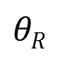
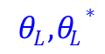

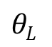
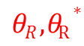
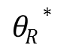
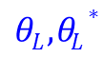
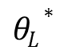

Coupling of oscillators
$θR , θR∗$
i
E
$θL , θL∗$
D
$$\text{j}$$
F
$$θL$$
Coupling at the level of internal state variables
$$θL∗$$
Coupling at the level of output variables
Coupling at the input level
$ψLi$, $ψLj$
$ψRi$, $ψRj$
$$θR∗$$
j
F
$$θR$$
D
$$i$$
E
$θR , θR∗$
$θL , θL∗$

Slide 9
Anti-phase / in-phase oscillations
Anti-phase
In-phase
Difference of activation (s)
Final phase difference
Time period of oscillation (s)
Notes:
Diagram of in-phase
Diagram of anti-phase
Diagram of basins of attraction
Consequences

Slide 10
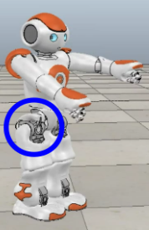

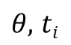
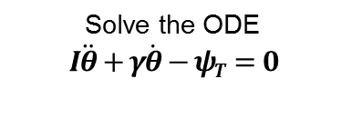
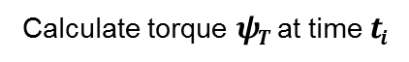
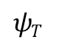
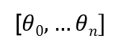

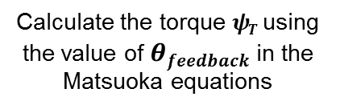
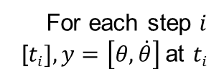
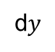

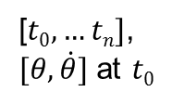
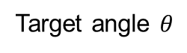
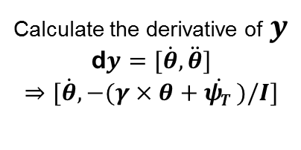
Robot Joint Control
Initialization
Mechanical Inertial System
Initialize the joint
Set parameters $I, γ$
Set oscillator parameters
[$t0,…tn]$,
$[θ, \dot{θ}]$ at $t0$
For each step $i$
[$ti], y=\left[θ, \dot{θ}\right]$at $ti$
Calculate torque $ψT$ at time $ti$
Set time steps
Calculate the derivative of $y$
d$y=[\dot{θ}, \ddot{θ}]$
$$⇒[\dot{θ}, −(γ×\dot{θ+ψT )/I]}$$
Solve the ODE
$$I\ddot{θ}+γ\dot{θ}−ψT=0$$
1
ODE
solver
2
8
7
[$θ0,…θn]$
d$y$
3
Robot Joint
2-7
6
$$ψT$$
$θ,$ $ti$
Target angle $θ$
Matsuoka Torque
4
Set joint to angle $θ$
Calculate the torque $ψT$ using the value of $θfeedback$ in the Matsuoka equations
5
Actual joint position $θfeedback$

Slide 11
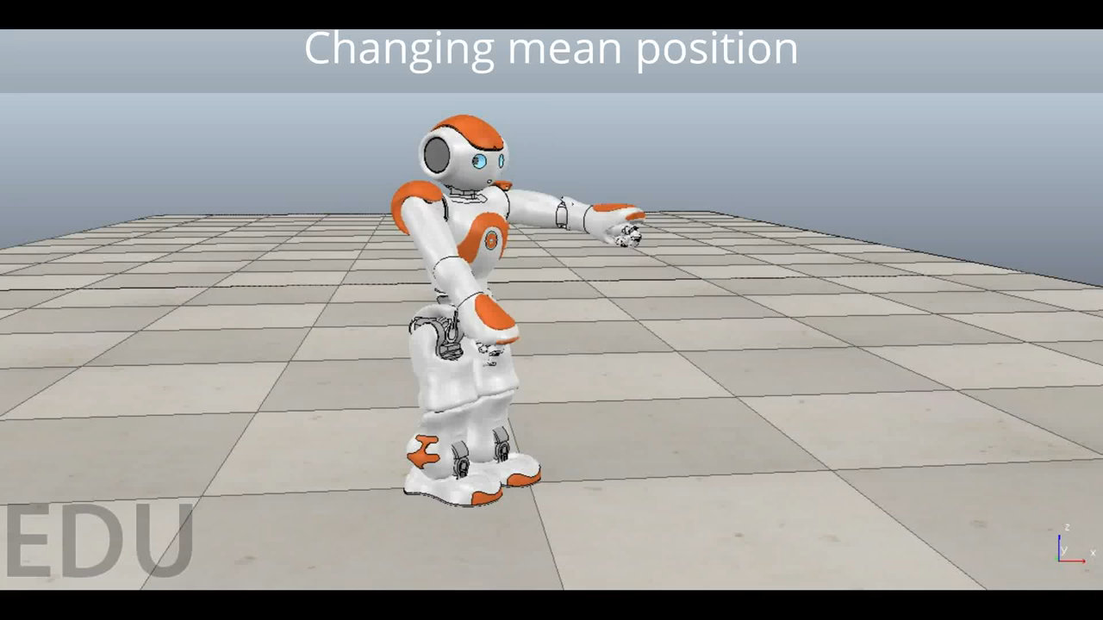
Joint Control Demonstration

Slide 12
Conclusion
Novelty and contribution of this work:
Sum up the approach
Sum op the results
...
Show that it solves the question
Open Questions:
Something
... is always missing

Slide 13
Future Work

Slide 14
The End
Thank you for your attention.
Any questions?
Literature:
Author , Author , Author, and Author. Name of the conference paper. In: Proceedings of the Conference Name, 2008
Author, Author, and Author. Name of the Article. Name of the Journal, 42:111-133, 2010
Author, and Author. Name of the Book. Publisher, 2009

